Slide 1


Evan Russel
18 May 2023

Slide 2

Outline
Executive Summary
Introduction
Methodology
Results
Conclusion
Appendix

Slide 3
Executive Summary
In this project, we will predict if the Falcon 9 first stage will land successfully. SpaceX advertises Falcon 9 rocket launches on its website with a cost of 62 million dollars. Therefore, if we can determine if the first stage will land, we can determine the cost of a launch.
Data collection from SpaceX API and use the web-scraping method. Then we do data wrangling cleaning the data. Using the cleaned data, we do EDA with visualization and SQL. Also made it interactive with dashboard. Then finally we do the predictive analysis using machine learning algorithm to make the best model to predict the upcoming flight
From the EDA result, Interactive analytics and predictive analysis, we could visualize and understand more about the SpaceX Falcon 9 data. And we get an accurate machine learning model to predict the future flights

Slide 4
Introduction
SpaceX has gained worldwide attention for a series of historic milestones. It is the only private company ever to return a spacecraft from low-earth orbit, which it first accomplished in December 2010. SpaceX advertises Falcon 9 rocket launches on its website with a cost of 62 million dollars whereas other providers cost upward of 165 million dollars each, much of the savings is because Space X can reuse the first stage.
In this Project, we will predict if the Falcon 9 first stage will land successfully. Therefore, if we can determine if the first stage will land, we can determine the cost of a launch. This information can be used if an alternate company wants to bid against SpaceX for a rocket launch.

Slide 5

Section 1

Slide 6
Methodology
Executive Summary
Data collection methodology:
Make a get request to the SpaceX API, and use BeautifulSoup web scraping from Wikipedia titled List of Falcon 9 and Falcon Heavy launches
Perform data wrangling
Deal with missing values, Normalization, data types, and categorical data
Perform exploratory data analysis (EDA) using visualization and SQL
Perform interactive visual analytics using Folium and Plotly Dash
Perform predictive analysis using classification models
We use SVM, Classification Trees and Logistic Regression

Slide 7
Data Collection
Data sets were collected from 2 different method:
Make a get request to the SpaceX API, giving us data about launches
using BeautifulSoup web scraping we can get data from Wikipedia website titled List of Falcon 9 and Falcon Heavy launches

Slide 8
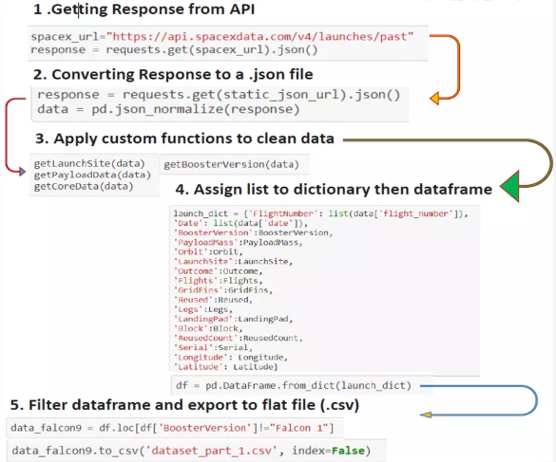
Data Collection – SpaceX API
https://github.com/Evanrsl/ibmdatascience/blob/64c28ef03ca963c09ab63ee5f3d8ddc86375c0b7/data%20collection%20API.ipynb

Slide 9
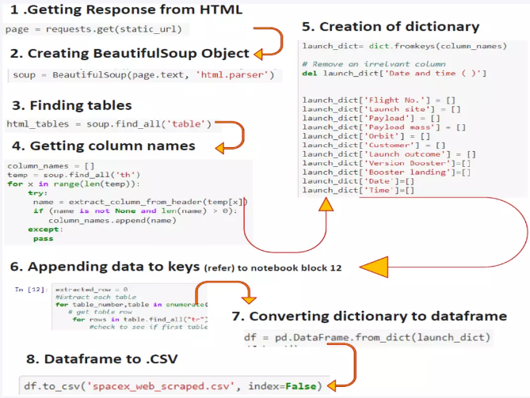
Data Collection - Scraping
https://github.com/Evanrsl/ibmdatascience/blob/main/web%20scraping%20lab.ipynb
Place your flowchart of web scraping here

Slide 10
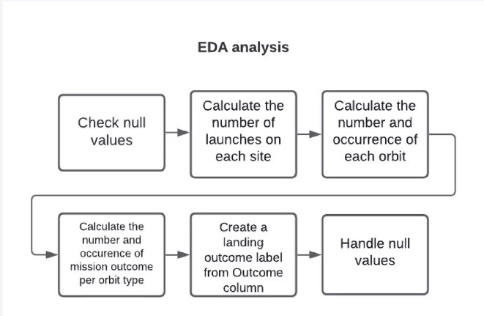
Data Wrangling
https://github.com/Evanrsl/ibmdatascience/blob/main/data%20wrangling.ipynb

Slide 11
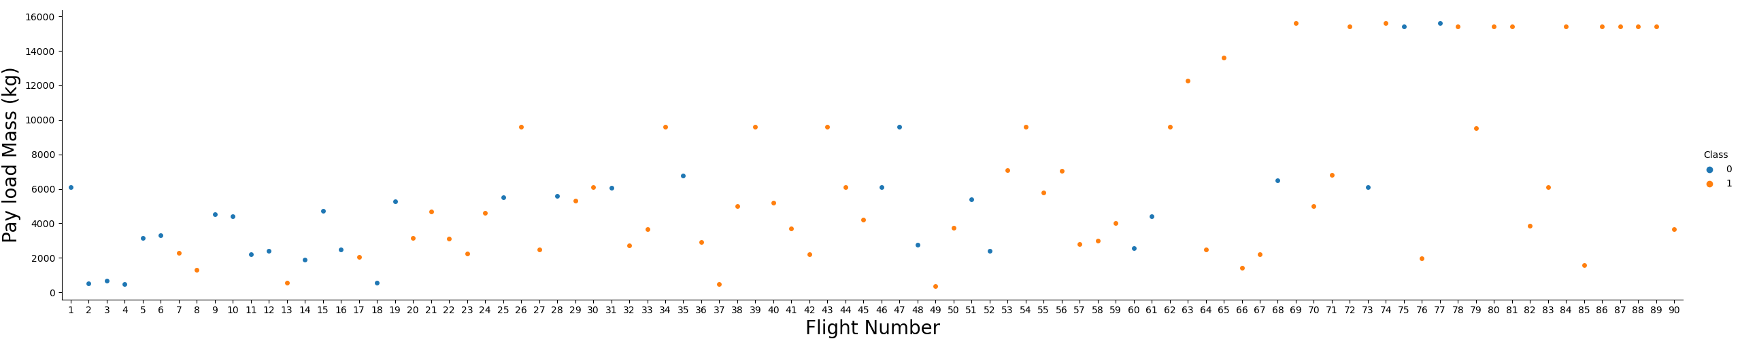
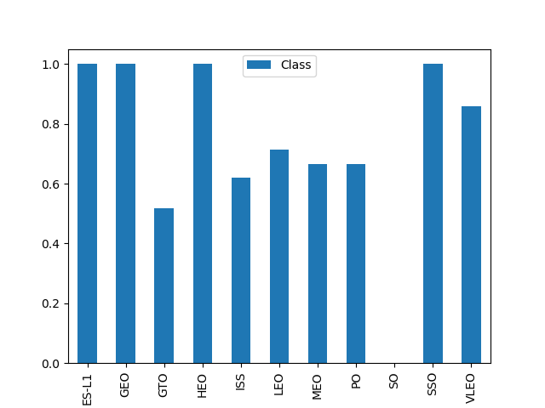
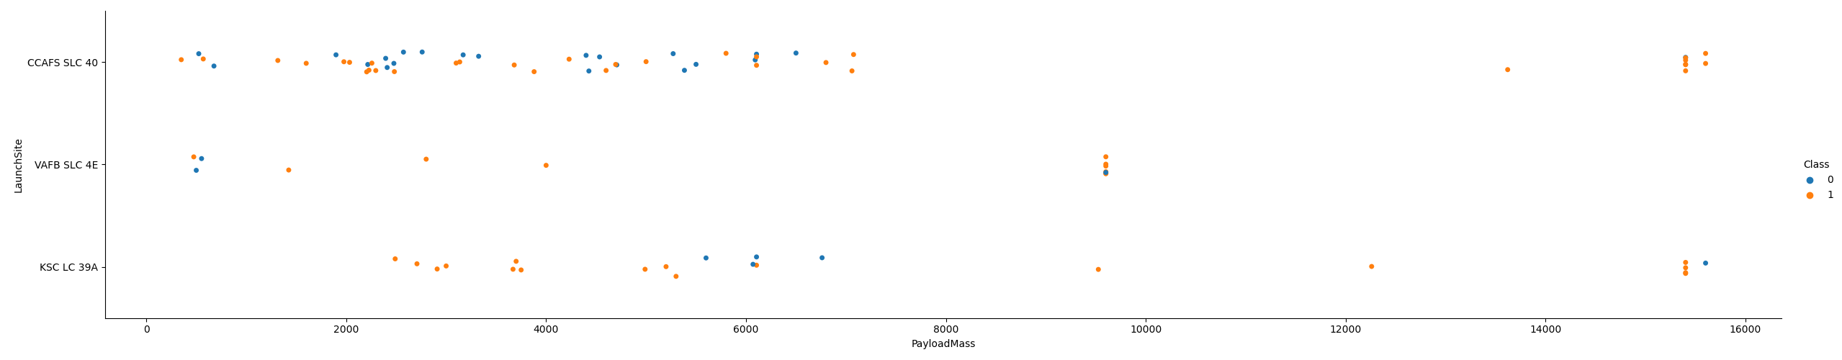
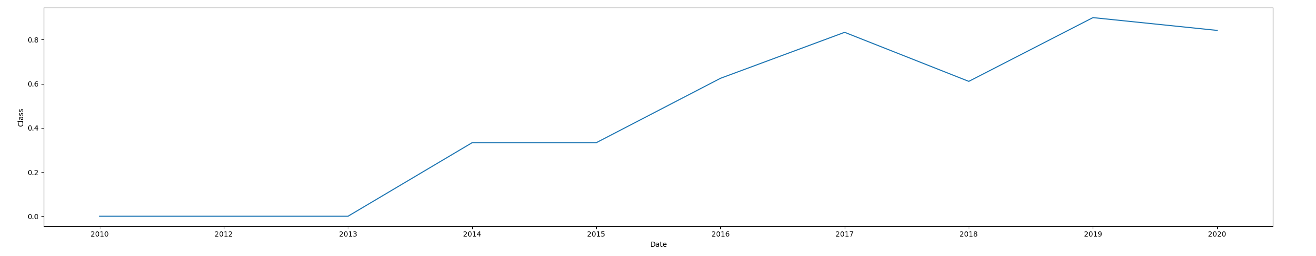
EDA with Data Visualization
https://github.com/Evanrsl/ibmdatascience/blob/main/EDA_Visualization.ipynb

Slide 12
EDA with SQL
Display the names of the unique launch sites in the space mission
Display 5 records where launch sites begin with the string 'CCA’
Display the total payload mass carried by boosters launched by NASA (CRS)
Display average payload mass carried by booster version F9 v1.1
List the date when the first successful landing outcome in ground pad was acheived.
List the names of the boosters which have success in drone ship and have payload mass greater than 4000 but less than 6000
List the total number of successful and failure mission outcomes
List the names of the booster_versions which have carried the maximum payload mass. Use a subquery
List the failed landing_outcomes in drone ship, their booster versions, and launch site names for in year 2015
Rank the count of landing outcomes (such as Failure (drone ship) or Success (ground pad)) between the date 2010-06-04 and 2017-03-20, in descending order
https://github.com/Evanrsl/ibmdatascience/blob/main/EDA%20with%20SQL.ipynb

Slide 13
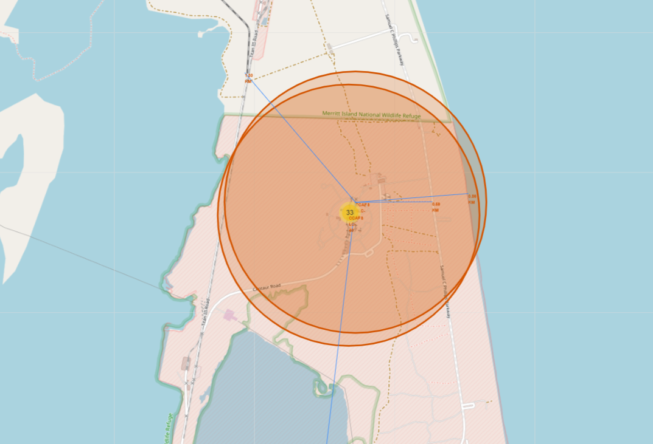
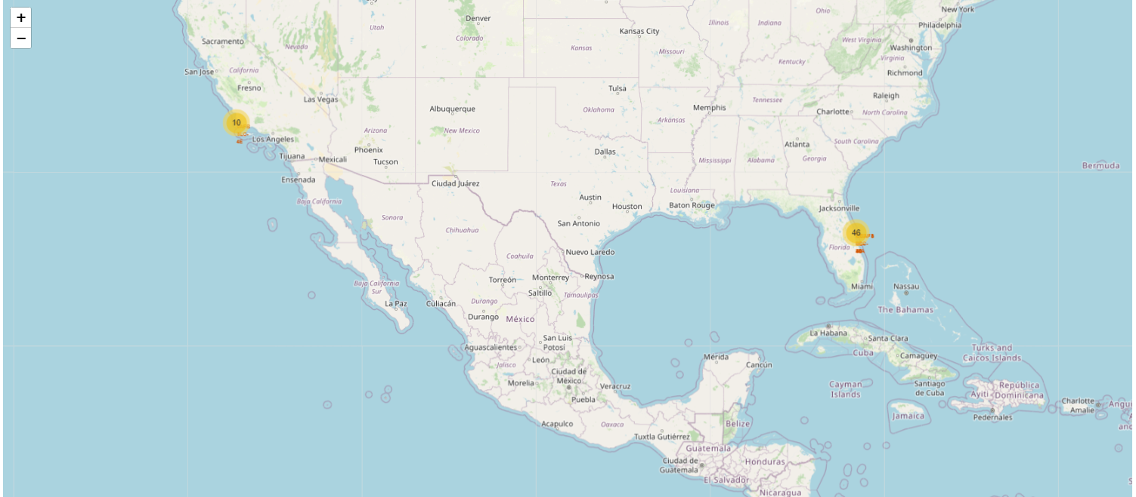
Build an Interactive Map with Folium
Map markers have been added to the map to find distances to closest city, railway, highway, etc.
https://github.com/Evanrsl/ibmdatascience/blob/main/Folium%20(1).ipynb

Slide 14
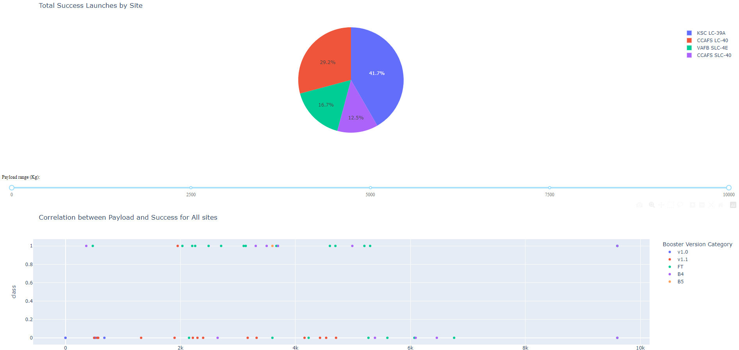
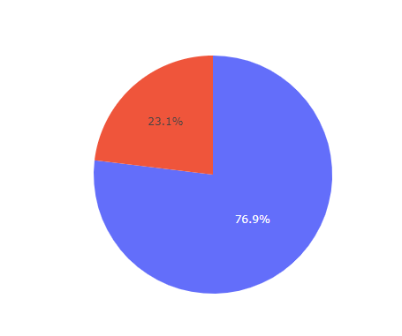
Build a Dashboard with Plotly Dash
We can see that KSC LC-39A had the most successful launches from all the sites. With 76.9% successful launches
https://github.com/Evanrsl/ibmdatascience/blob/main/spacex_dash_app.py

Slide 15
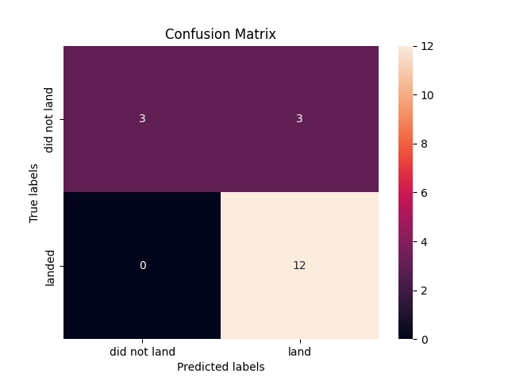
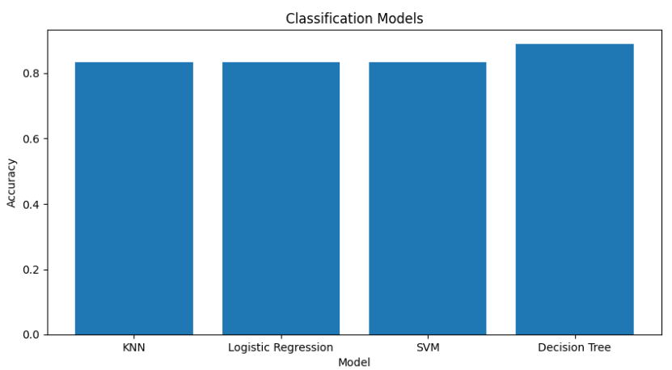
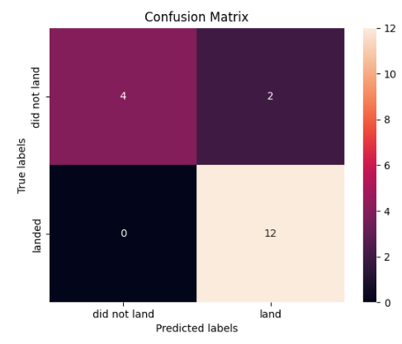
Predictive Analysis (Classification)
We use several machine learning algorithm such as SVM, KNN, Decision Tree and Logistic Regression model. Decision Tree get the best accuracy of 88.8%
https://github.com/Evanrsl/ibmdatascience/blob/main/Predictive_Analysis%20(1)%20(1).ipynb

Slide 16
Results
All machine learning models performs with the same accurace in terms of prediction for this dataset
Low weighted payloads perform better than the heavier payloads
The success rates for SpaceX launches is directly proportional time in years they will eventually perfect the launches
KSC LC 39A had the most successful launches from all the sites
Orbit GEO,HEO,SSO,ES-L1 has the best success rate

Slide 17

Section 2

Slide 18
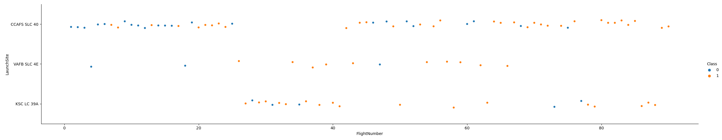
Flight Number vs. Launch Site
Launch site CCAFS SLC 40 has the most flight compared to other launch sites, while VAFB SLC 4E has the least flights.

Slide 19
Payload vs. Launch Site
Most of the lower mass payloads have been launched from CCAFS SLC 40

Slide 20
Success Rate vs. Orbit Type
The orbit type ES-L1, GEO, HEO, and SSO have the highest success rate

Slide 21
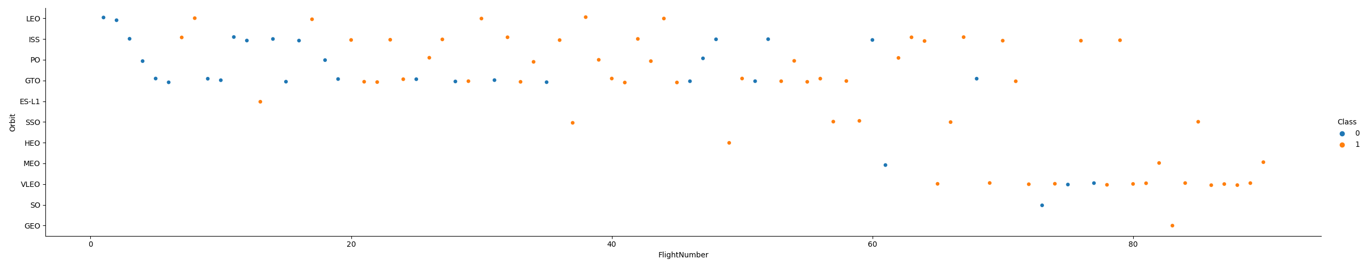
Flight Number vs. Orbit Type
Flights with VLEO orbit type becomes more often in recent years, while GTO becomes less

Slide 22
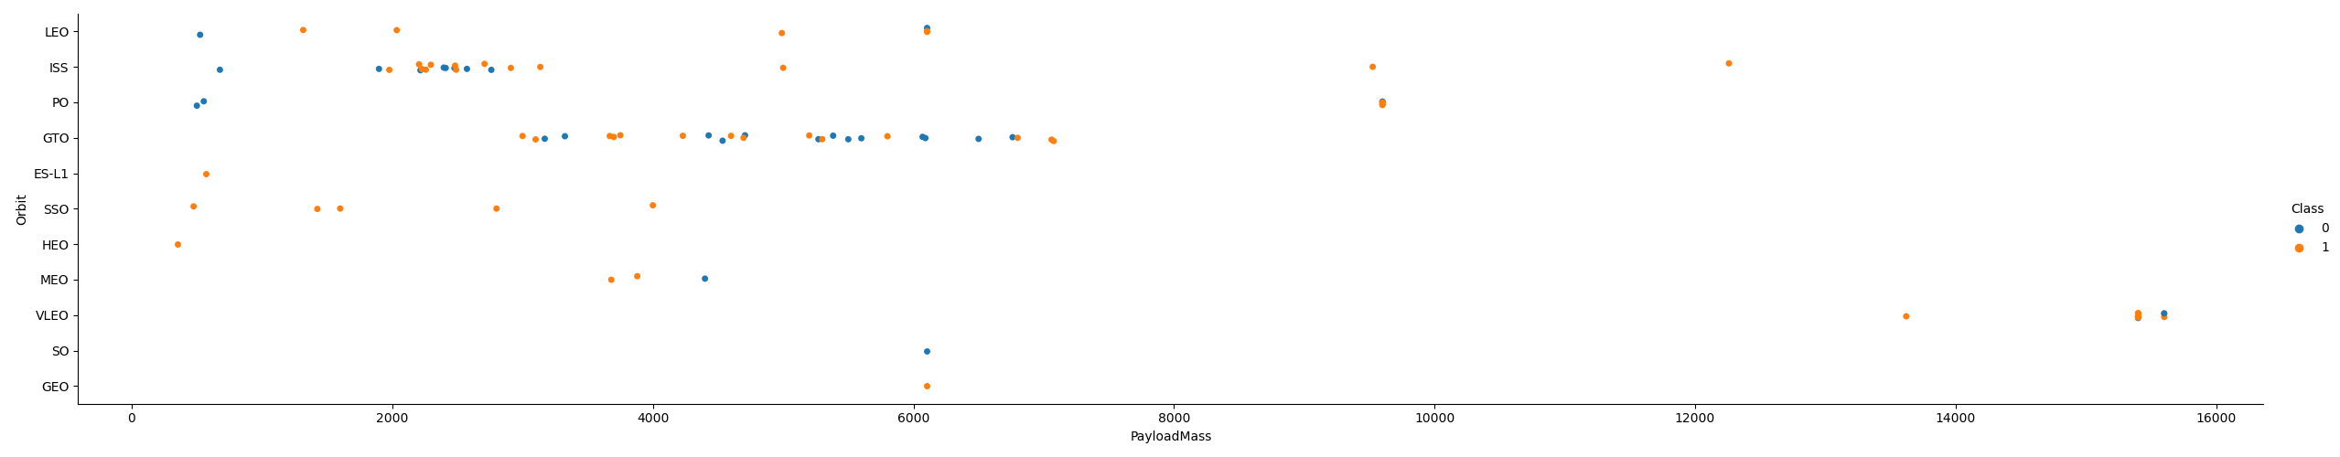
Payload vs. Orbit Type
There are more flights with ISS orbit type with payload around 2000, and GTO orbit type in the range of 4000-8000

Slide 23
Launch Success Yearly Trend
Launch success rate has increased significantly since 2013

Slide 24
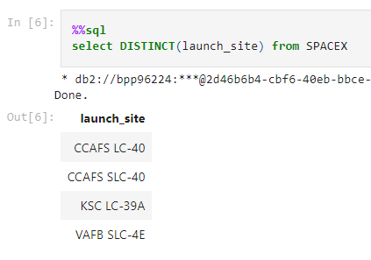
All Launch Site Names

Slide 25
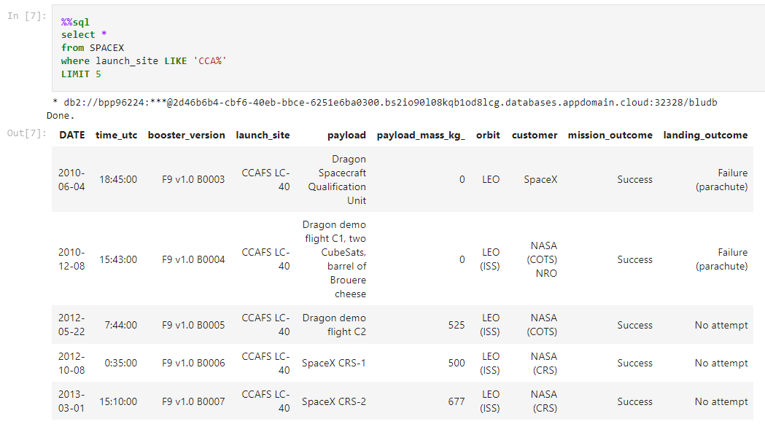
Launch Site Names Begin with 'CCA'

Slide 26
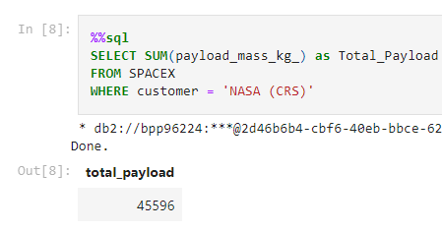
Total Payload Mass

Slide 27
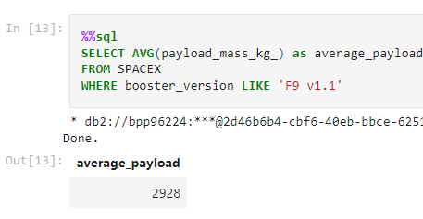
Average Payload Mass by F9 v1.1

Slide 28
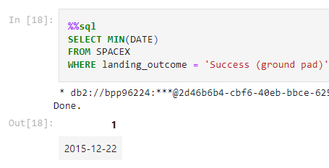
First Successful Ground Landing Date

Slide 29
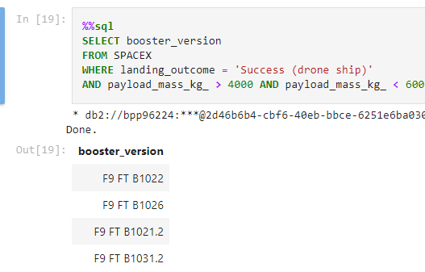
Successful Drone Ship Landing with Payload between 4000 and 6000

Slide 30
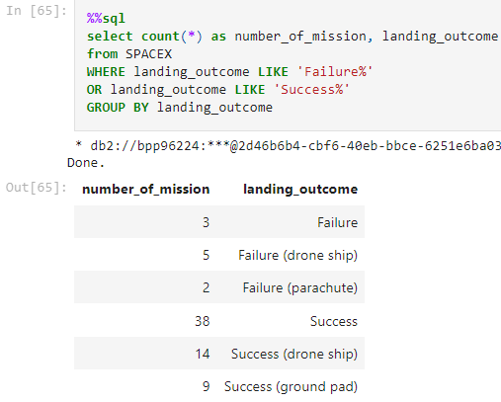
Total Number of Successful and Failure Mission Outcomes

Slide 31
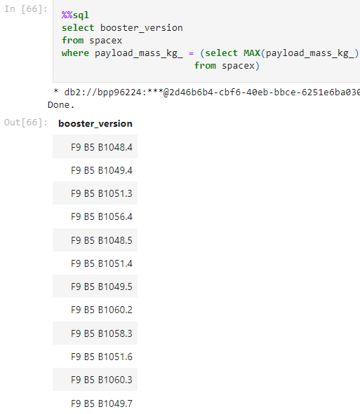
Boosters Carried Maximum Payload

Slide 32
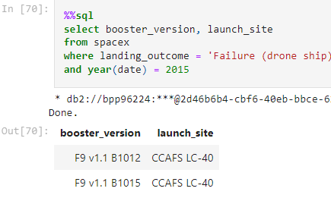
2015 Launch Records

Slide 33
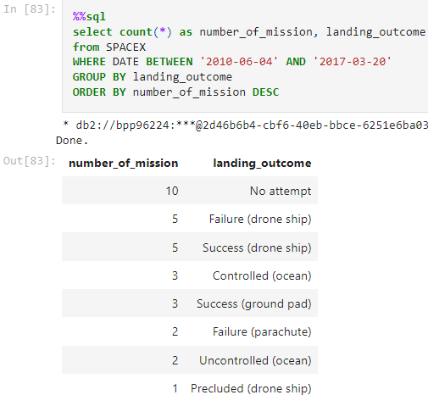
Rank Landing Outcomes Between 2010-06-04 and 2017-03-20

Slide 34

Section 3

Slide 35
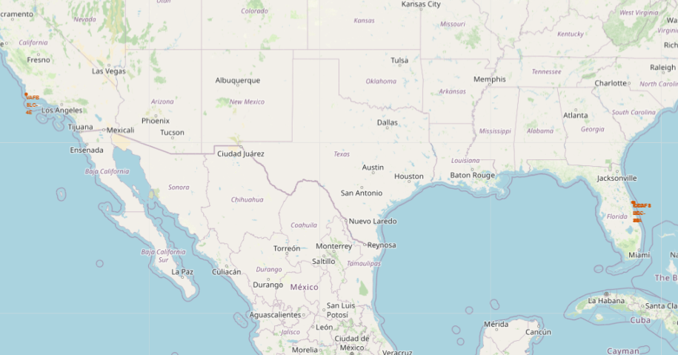
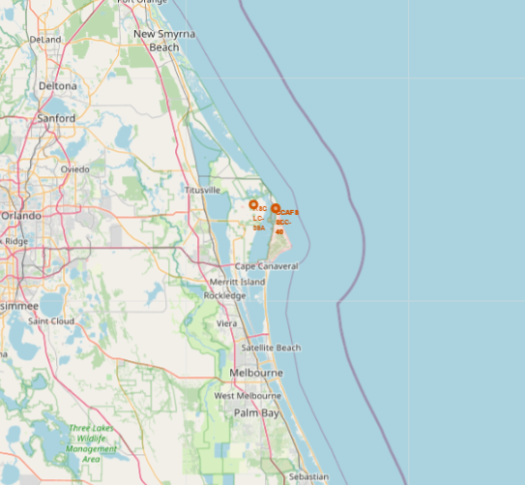
All launch sites marked on a map
KSC LC-39A, CCAFS LC-40, and CCAFS SLC-40 are near resulting in stacked label

Slide 36
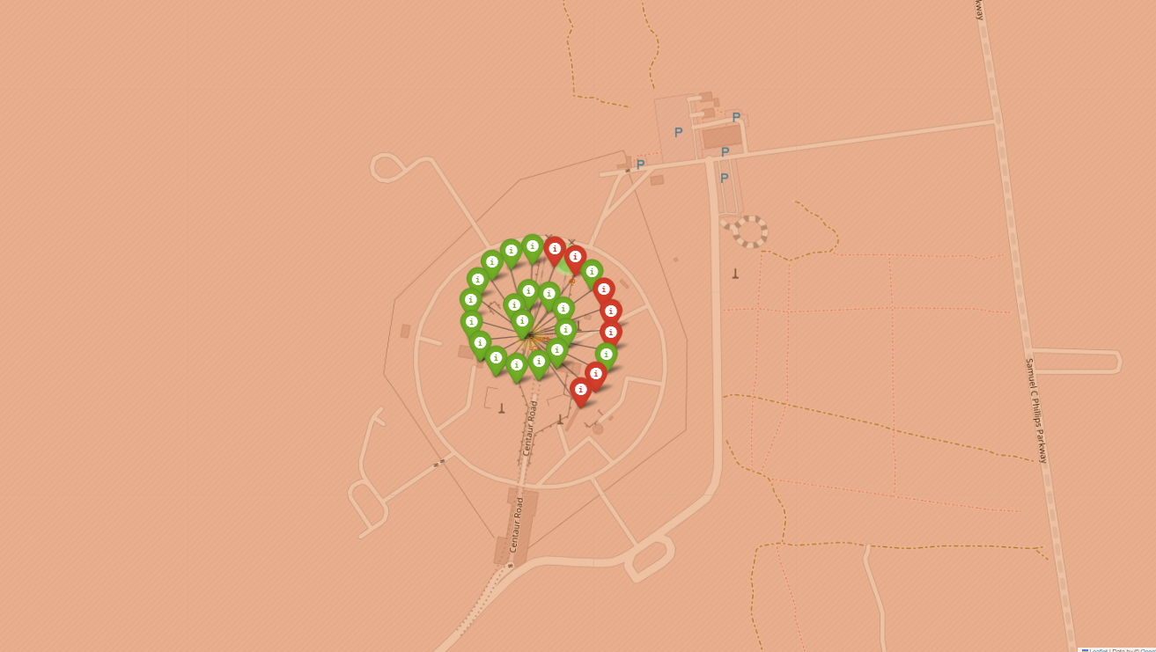
Success / failed launches marked on the map
Launch site CCAFS LC-40

Slide 37
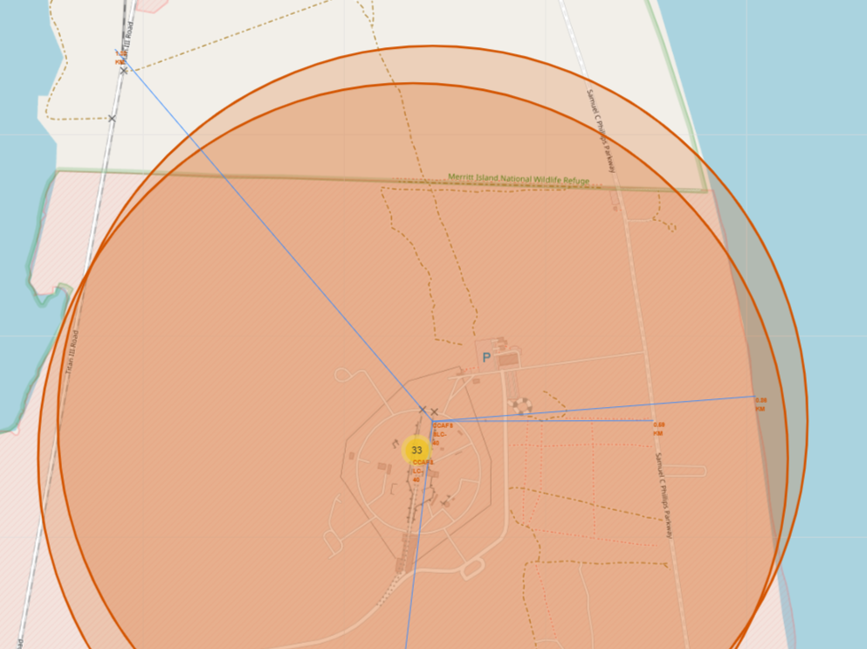
Distances between a launch site to its proximities
Launch site CCAFS SLC-40 distance with nearest railroad is 1.3 KM, Coastline 0.86 KM, highway 0.59 KM, and nearest city 51.19 KM

Slide 38

Section 4

Slide 39
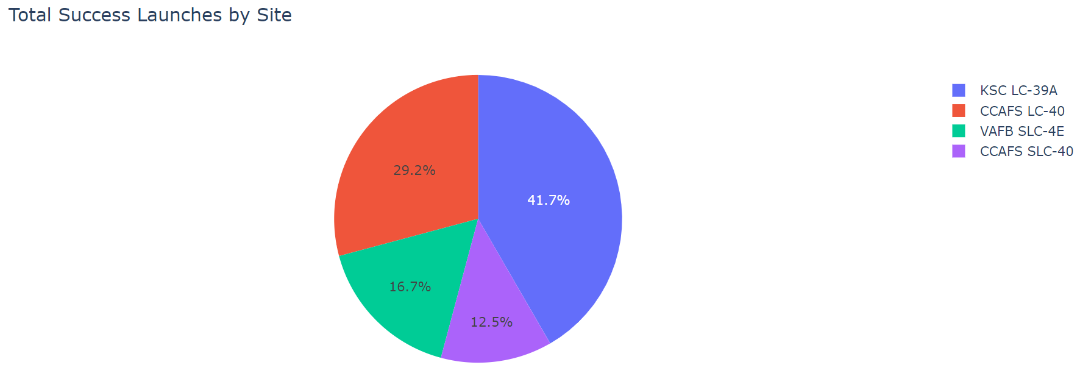
Total success launches by all sites
KSC LC-39A had the most successful launches from all the sites

Slide 40
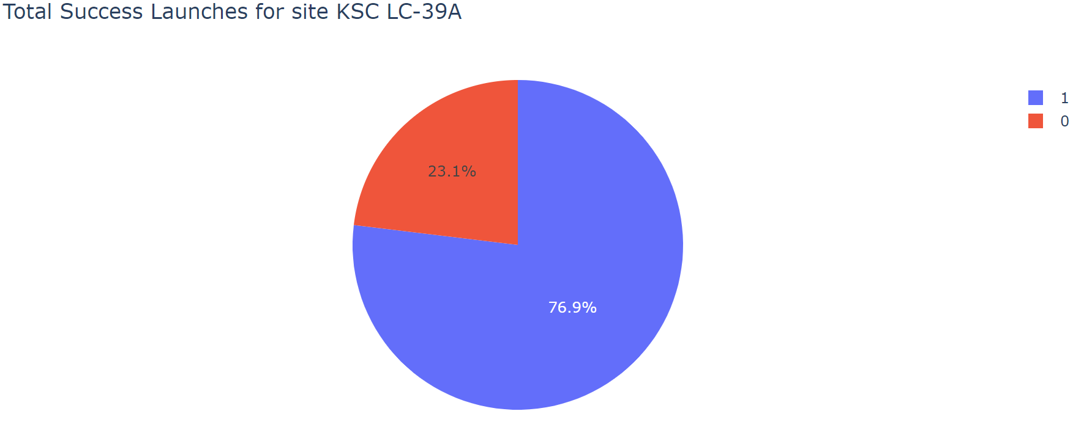
Success rate of KSC LC-39A
KSC LC-39A achieved a 76.9% success rate and with 23.1% failure rate

Slide 41
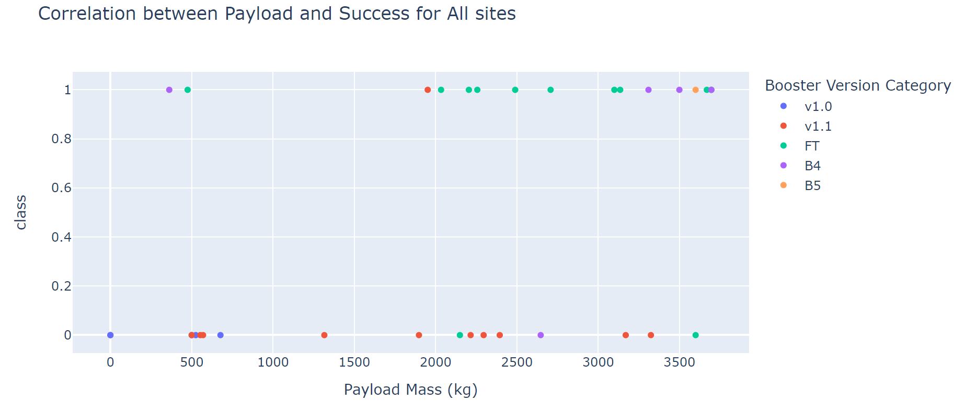
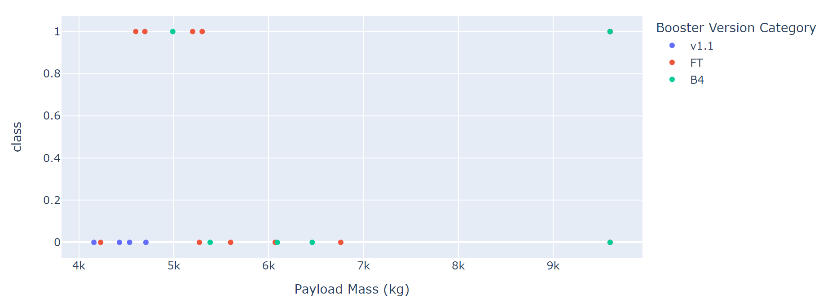
Payload vs launch outcome
Lower payloads has more success flights than higher payloads

Slide 42

Section 5

Slide 43
Classification Accuracy
Decision Tree has the highest accuracy of 0.88

Slide 44
Confusion Matrix
Confusion matrix of decision tree

Slide 45
Conclusions
The larger the flight amount at a launch site, the greater the success rate at a launch site.
Launch success rate started to increase in 2013 till 2020
Orbits ES-L1, GEO, HEO, SSO, VLEO had the most success rate.
KSC LC-39A had the most successful launches of any sites.
Decision Tree algorithm works the best with accuracy of 0.88.
By using the machine learning model, we can predict if the first stage of out competitor will land and determine the cost of a launch

Slide 46
Appendix
https://github.com/Evanrsl/ibmdatascience/tree/main

Slide 47


